Slide 1

Struts Basics
Concepts and Testing

Slide 2
Overview
Request from Browser
Handled by ActionServlet
  Reads stuts-config.xml
  Loads data into LogonForm.java
  Runs LogonAction.java
    Which talks to the domain layer to do it’s business.
  Forward to a Logon.jsp to render the html.

Slide 3
Parts
Struts-config.xml -configuration
JSP pages - presentation
Form - java class for JSP data with simple validation
Action – java class for web behavior
Mapping elements
  <global-forwards> list of <forward>
  <forward> - logical name for a hyperlink to a resource
  <form-beans> list of <form-bean>
  <form-bean> - logical name for a java data class
  <action-mappings> list of <action>
  <action> - puts all the parts together to handle a request
Domain (aka Buisness layer) – Does the non-Web, non-DB logic.

Slide 4
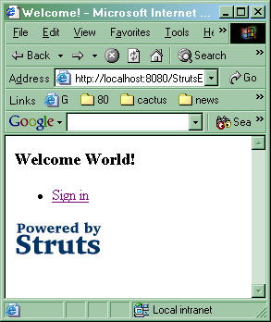
Welcome
<H3>Welcome World!</H3>
<UL>
<LI>
<html:link forward="logon">Sign in</html:link>
</LI>

Slide 5
Config Forwards
<!-- === Global Forward Definitions ======== -->
<global-forwards>
<forward name="welcome" path="/Welcome.do" />
<forward name="logon" path="/Logon.do" />
<forward name="logoff" path="/Logoff.do"/>
</global-forwards>
From the Welcome JSP:
<html:link forward="logon">Sign in</html:link>
The Action Mapping to which to Forward.

Slide 6
Config Login.do
<!-- ===== Action Mapping Definitions ========= -->
<action-mappings>
<action
forward="/pages/Logon.jsp"
path="/Logon"/>

Slide 7
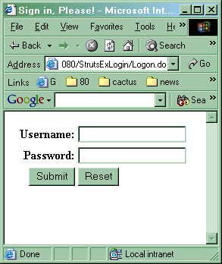
Logon JSP
<html:form action="/LogonSubmit" focus="username">
<TABLE border="0" width="100%">
<TR>
<TH align="right">Username:</TH>
<TD align="left"><html:text property="username"/></TD>
</TR>
<TR>
<TH align="right">Password:</TH>
<TD align="left"><html:password property="password"/></TD>
</TR>
<TR>
<TD align="right"><html:submit/></TD>
<TD align="left"><html:reset/></TD>
</TR>
</TABLE>

Slide 8
Config: Logon Submit
path name embedded in the JSP
<!-- ========== Action Mapping Definitions ===== -->
<action
path="/LogonSubmit"
type="app.LogonAction"
name="logonForm"
scope="request"
validate="true"
input="/pages/Logon.jsp">
<forward
name="success"
path="/pages/Welcome.jsp"/>
</action>
Java class to use for behavior
Logical name to use for the data (next slide)
How long to keep the data around
Should it call LoginForm.validate()
Go here if validate() returns false
Where to go if all is well

Slide 9
Config Form-Beans
<struts-config>
<!-- ========== Form Bean Definitions ========== -->
<form-beans>
<form-bean
name="logonForm"
type="app.LogonForm"/>
</form-beans>
Name
Class app.LogonForm.java
That has getters and setters for Form data

Slide 10
LogonForm.java
public final class LogonForm extends ActionForm {
public LogonForm() { reset(); }
private NonEmptyString password;
private NonEmptyString username;
private JspProperty properties;
public String getPassword() {
return (this.password.get());
}
public void setPassword(String password) {
this.password.set(password);
}
// …

Slide 11
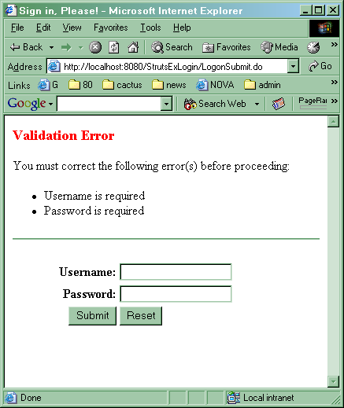
Validation Errors
<BODY>
<html:errors/>
<html:form action="/LogonSubmit" focus="username">
<TABLE border="0" width="100%">
<TR>
<TH align="right">Username:</TH>
<TD align="left"><html:text property="username"/></TD>
</TR>
…

Slide 12
Form Validation 1
public final class LogonForm extends ActionForm {
public LogonForm() { reset(); }
private NonEmptyString password;
private NonEmptyString username;
private JspProperty properties;
public String getPassword() {
return (this.password.get());
}
public void setPassword(String password) {
this.password.set(password);
}

Slide 13
Form Validation 2
// called by Struts
public void reset(ActionMapping mapping, HttpServletRequest request)
{ reset(); }
void reset() {
properties = new JspProperty();
username = new NonEmptyString("username", "error.username.required");
properties.add(username);
password = new NonEmptyString("password", "error.password.required");
properties.add(password);
}
// called by Struts
public ActionErrors validate( ActionMapping mapping, HttpServletRequest request) {
ActionErrors errors = new ActionErrors();
properties.validate(errors); // collection parameter (aka. pass the hat)
return errors;
}
} // end of class

Slide 14
LoginAction
public final class LogonAction extends Action {
public ActionForward execute( ActionMapping mapping, ActionForm form,
HttpServletRequest request,HttpServletResponse response) throws Exception {
boolean validated = false;
try {
validated = isUserLogon((LogonForm) form);
} catch (UserDirectoryException ude) {
return errorActionForward("error.logon.connect", request, mapping);
}
if (!validated) {
return errorActionForward("error.logon.invalid", request, mapping);
}
HttpSession session = saveUserIntoSession(form, request);
logMessages(form, session);
return successActionForward(mapping);
} // …

Slide 15
Testing Struts
[ Code Demo ]
Project StrutsLogin
In the Download section of : www.objectwind.com

